Slide 1
Machine Learning on
Molecular Structure
Peter St. John
peter.stjohn@nrel.gov
RMACC
May 22th, 2019

Slide 2
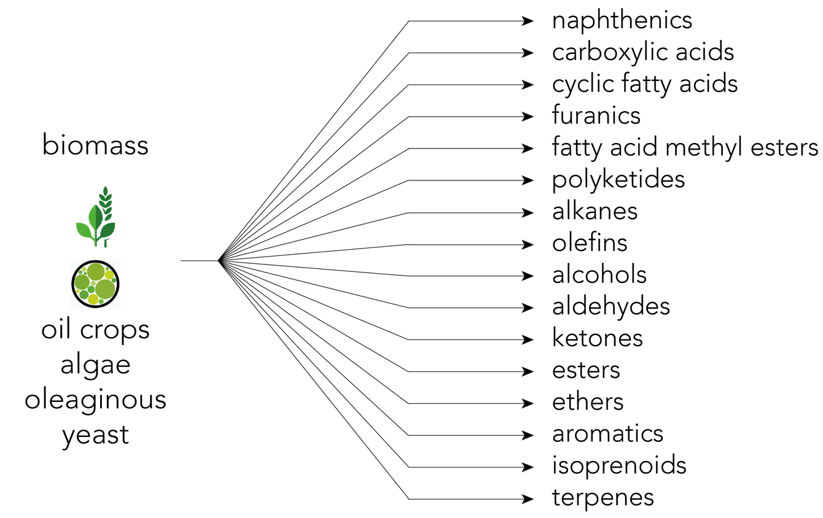
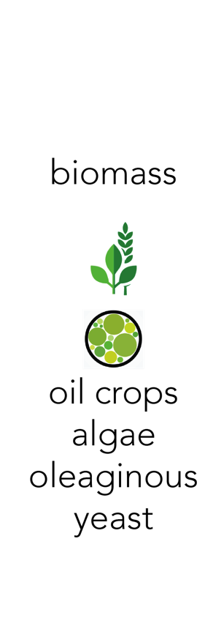

Slide 3
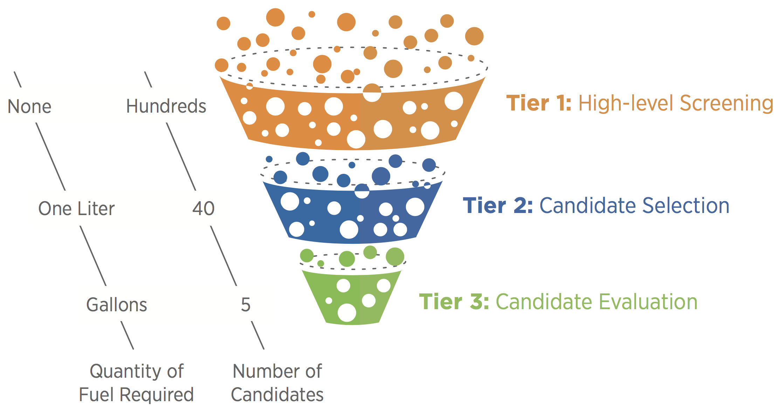
Fuel selection criteria (“decision funnel”)

Slide 4
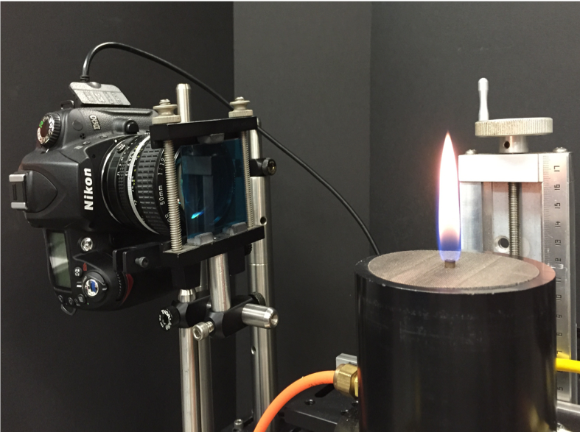
Yield Sooting Index
Methane Flame +
1000 ppm dopant
Measures chemical tendency of molecule to form soot
Current database > 500 molecules
Species CAS YSI
14 anthracene 120-12-7 962.6
346 3-methylbutanal 590-86-3 27.9
305 2-hexanol 626-93-7 34.1
430 methanol 67-56-1 6.6
467 propargylamine 2450-71-7 25.4
... ... ... ...
Collaboration with Charles McEnally & Lisa Pfefferle, Yale
Notes:
Add collaborators

Slide 5
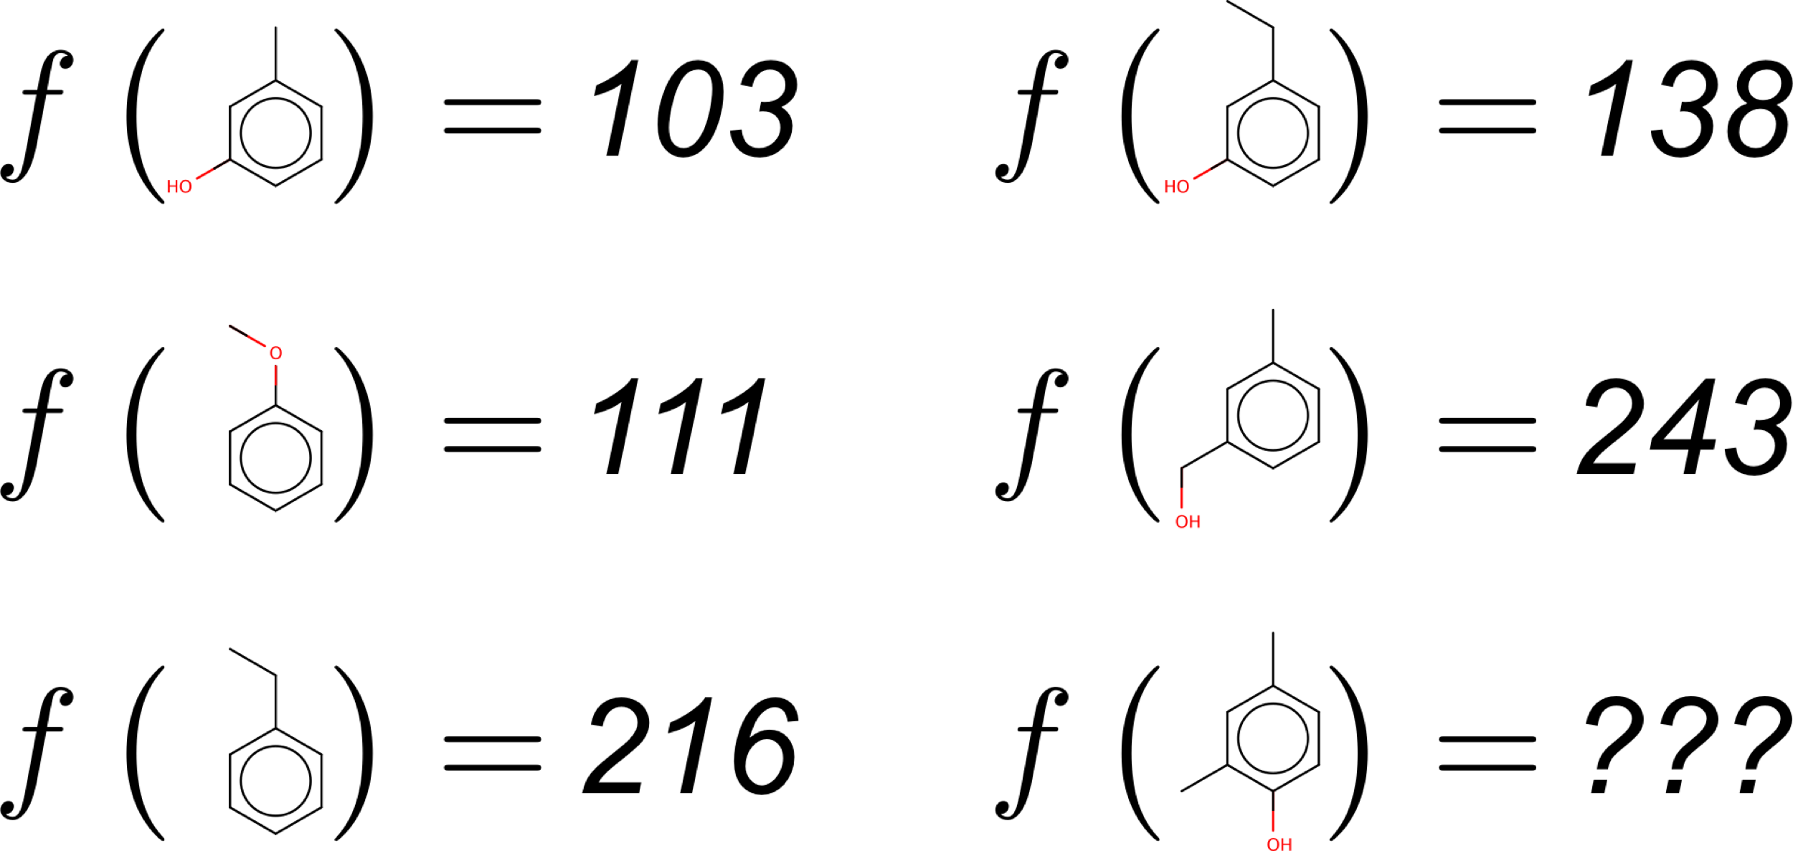
Creating functions that operate on molecular structure

Slide 6
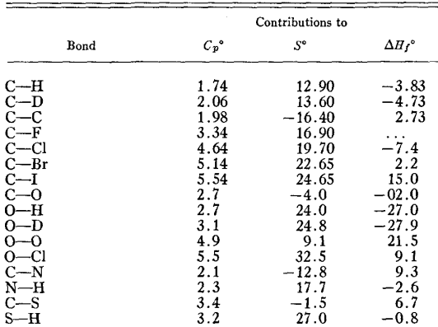
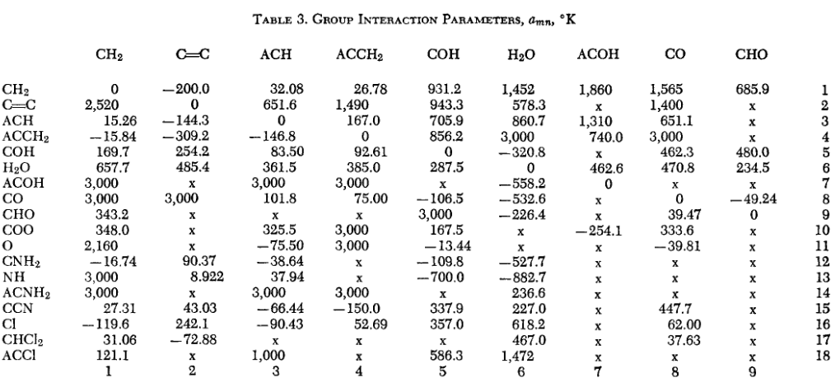
Predicting properties from molecular structure
Benson & Buss Group Additivity (1958)
Mathematically predicting molecular properties as a function of chemical structure has a long history (Langmuir, 1925)
Applications at NREL:
Fuels, Polymers, Electronic Properties
UNIFAC Method Group Interaction Parameters (1975)
Fredenslund, A., Jones, R. L., & Prausnitz, J. M. (1975). AIChE Journal, 21(6), 1086–1099.

Slide 7
Methods for Quantitative Structure-Property Relationship models
Molecular Embedding
Determine a scheme to map molecules to a continuous vector space
Regression
Fit a function that maps that vector space to the desired property

Slide 8
Traditional breakdown of molecular embedding methods
0d: Atom counts, bond counts, molecular weight 1d: Group contribution methods 2d: Graph-invariant functions 3d: Functions that include 3D geometry, (i.e., conformer specific)

Slide 9
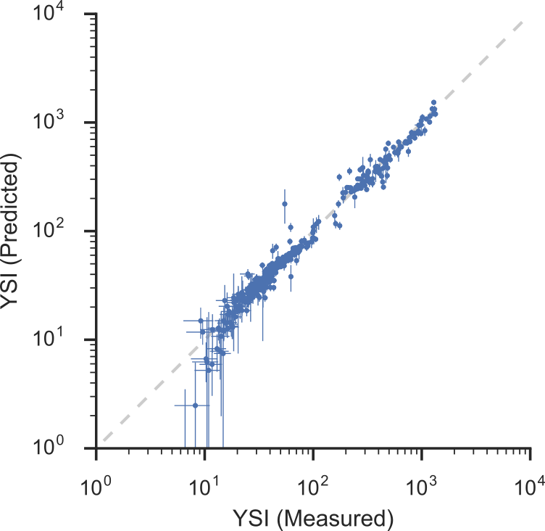
Development of a group-contribution YSI model
Input molecules are decomposed into individual carbon-type fragments
Bayesian linear regression is used to find the YSI contributions from each atom type
Regressed model is accurate across several orders of magnitude
The final YSI prediction is a sum of contribution from each carbon atom in the molecule

Slide 10
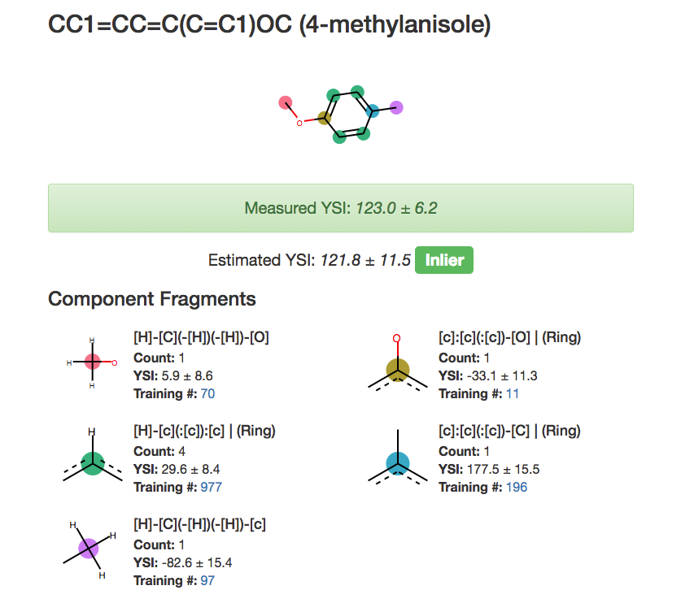
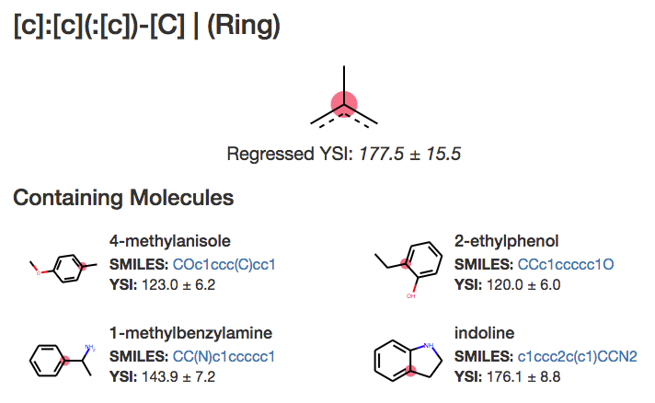

Online, Interactive YSI prediction
Model deployed as online web app
Shows breakdown of predictions; where structural data is lacking
ysipred.herokuapp.com

Slide 11
End-to-end learning
Instead of manually determining a method to convert a molecule into a finite-dimensional numerical representation, can we “learn” an optimal embedding?

Slide 12
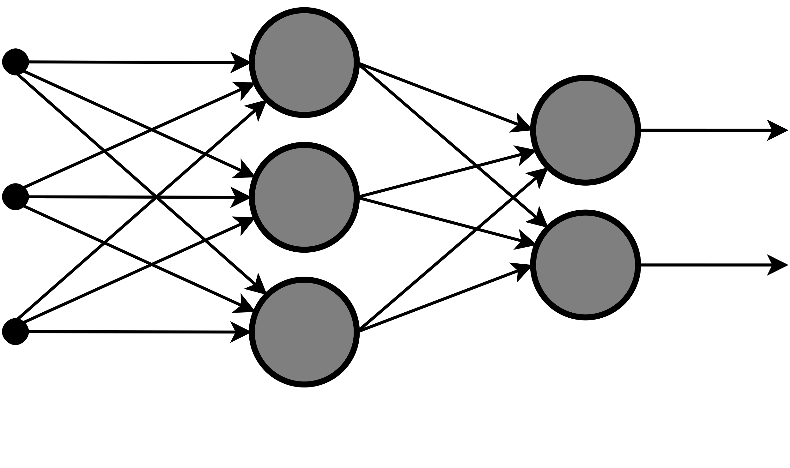
Basics of Neural Networks
Inputs
Neural Network models map a vector of inputs to a vector of outputs through a series of linear algebra transformations
Predictions

Slide 13
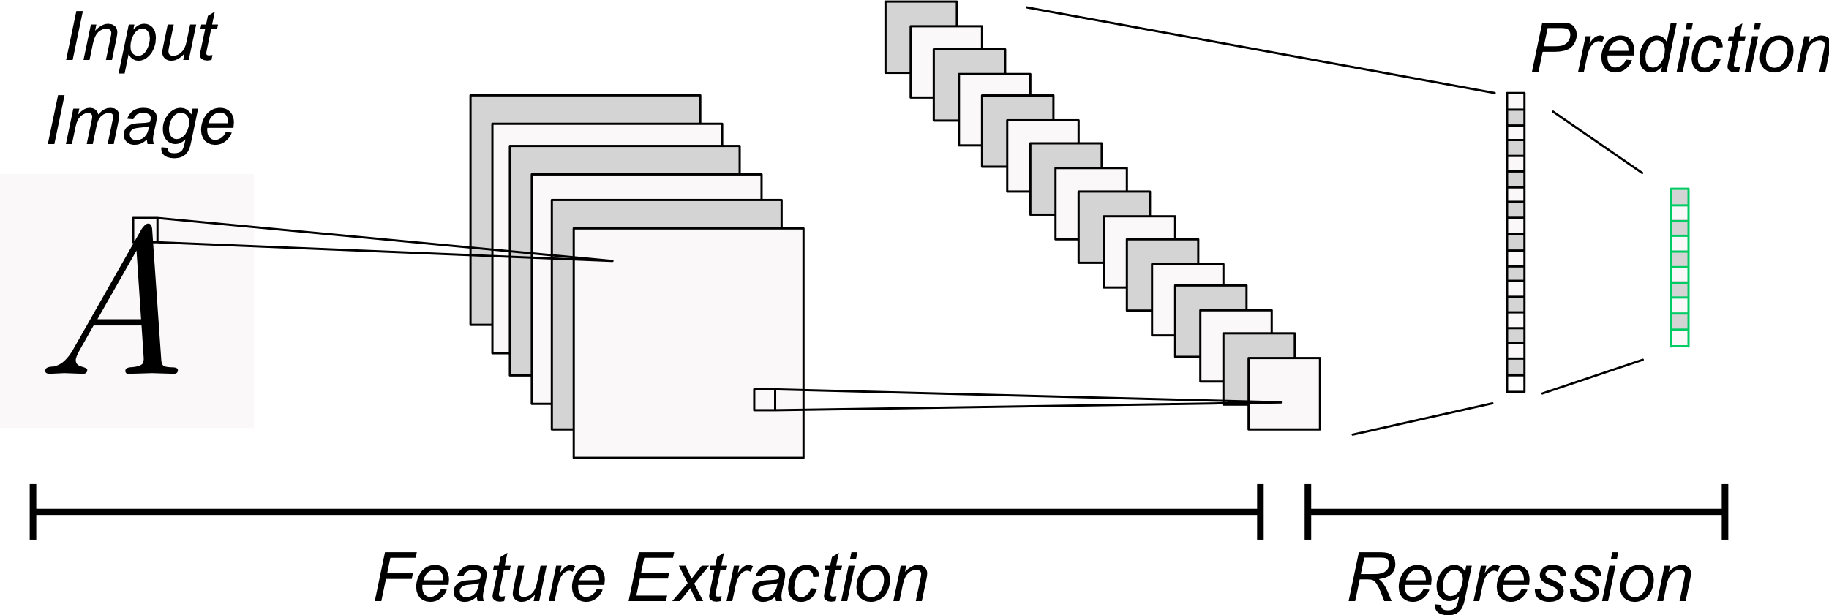
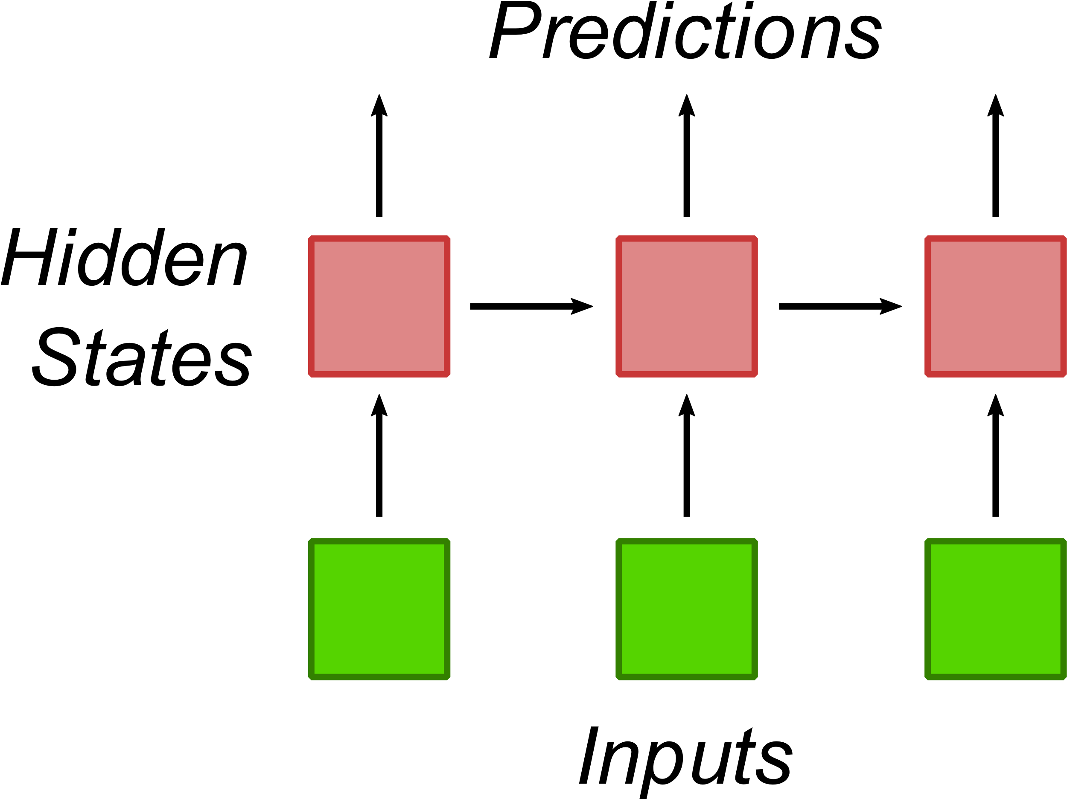
Extending neural networks to handle non-vector inputs
Convolutional Networks
Recurrent Networks
Uses sliding kernels to extract image features
Replaces traditional methods of using hand-tuned kernels for feature extraction
Extension to allow network to handle variable-sized sequences
Predicts a sequence of outputs from a sequence of inputs

Slide 14
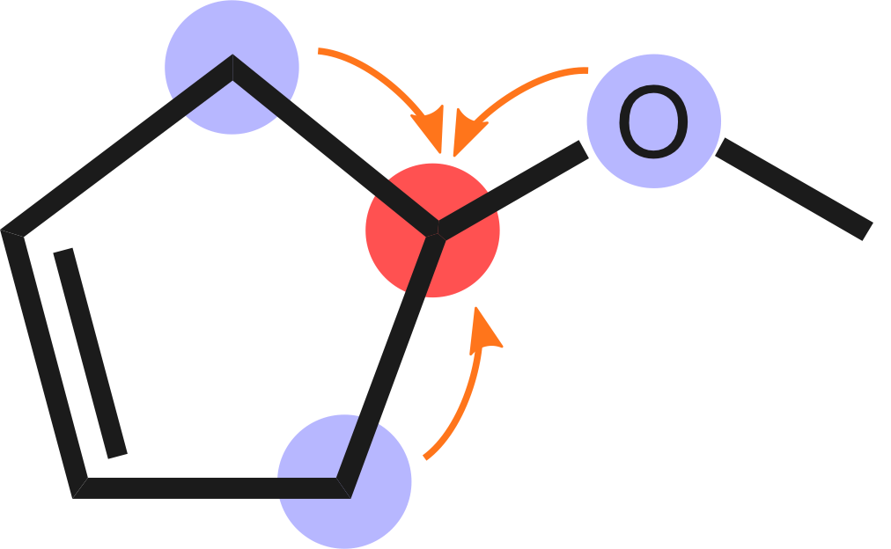
Message Passing Neural Networks
End-to-end strategies for molecular systems are under active development
Atoms iteratively look at nearby atoms to update their numerical representation
Single step from atomic structure to prediction
Optimal molecular representation ‘learned’ from the data
Gilmer et al. (2017) Neural Message Passing for Quantum Chemistry, arXiv:1704.01212

Slide 15
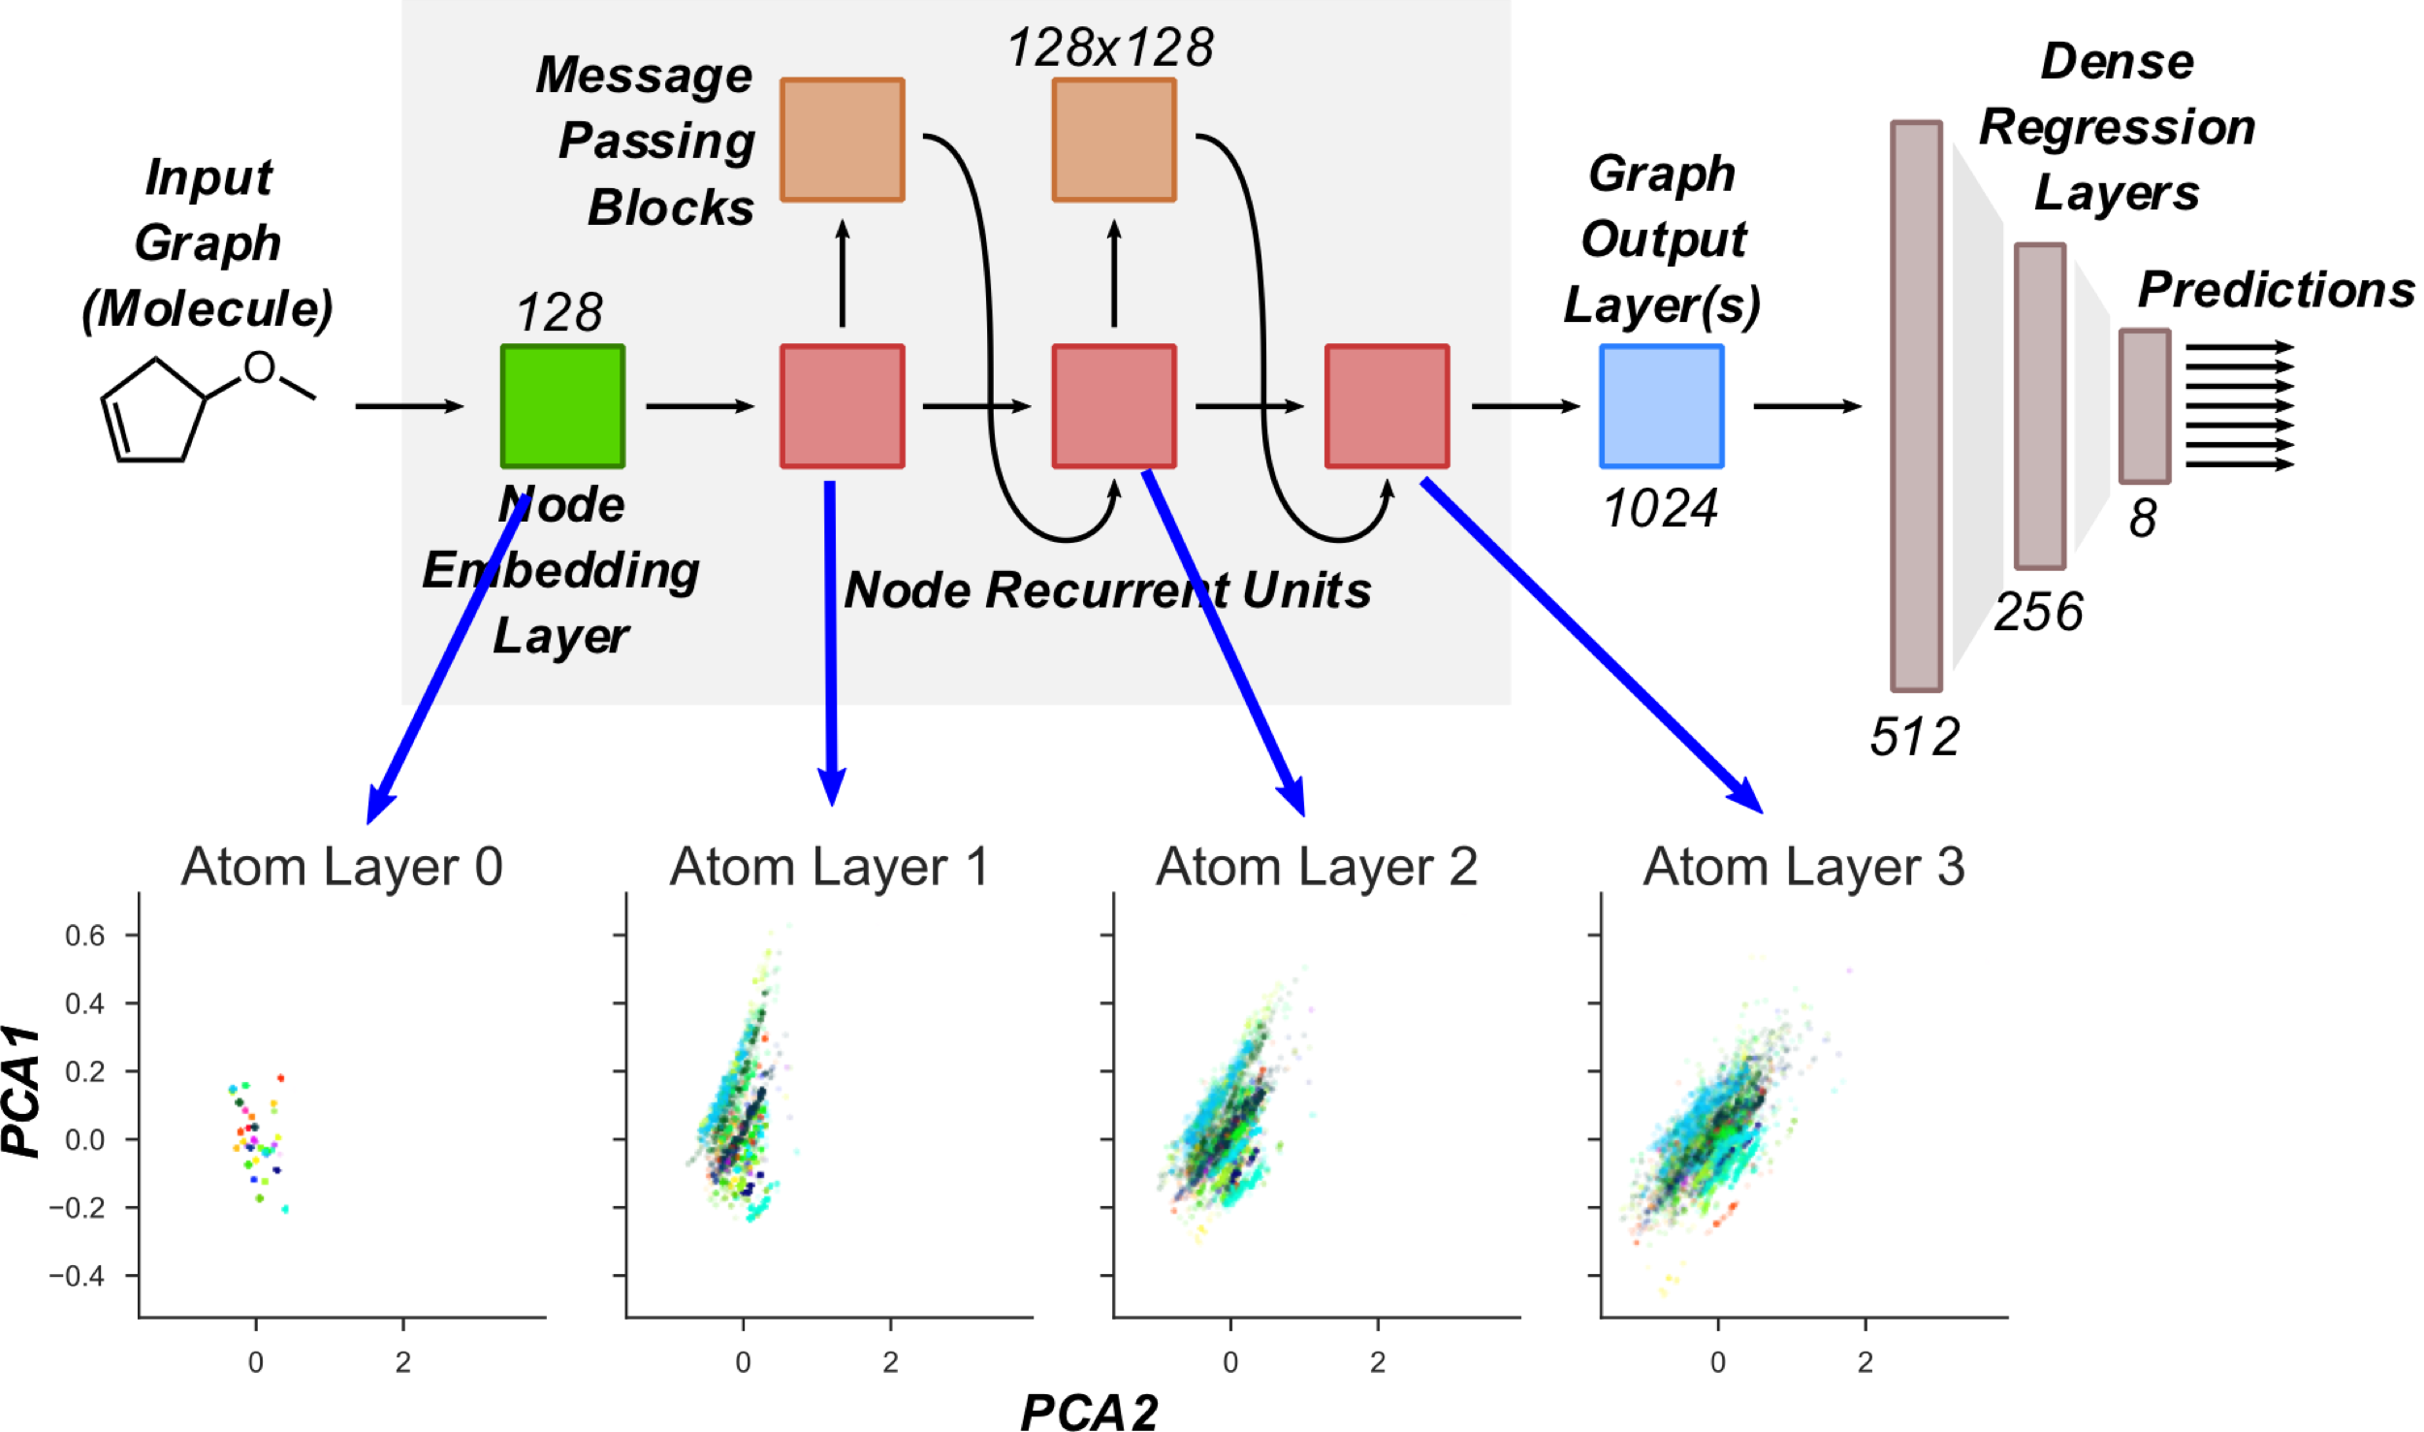
End to End Learning on Molecular Structure
Notes:
Traditional machine learning tries to predict a target as a function of a vector-based input.
But, many interesting problems are difficult to represent as vectors: i.e. images, text, molecules
In end-to-end learning, a model simultaneously learns how to represent the input as a vector and how to turn that vector into a prediction
These strategies have revolutionized image recognition and natural language processing, but took two key ingredients:
1) A neural network structure that naturally handled these inputs (Convolutional neural nets for images, recurrent neural nets for text)
2) Sufficient data to train the (often millions to billions) of parameters.
On (2), end-to-end approaches only started to beat traditional feature engineering strategies once the available data reached millions or images or lines of text.
A similar situation arises in chemical property prediction. For decades, the field of cheminformatics has developed suitable, hand-engineered methods to convert molecular structures to a vector suitable for input into machine learning algorithms.
But in recent years, there have been a few neural network structures published that naturally take molecular structures as inputs.
These neural networks have shown best-in-class performance on predicting large-scale, quantum chemistry datasets.

Slide 16
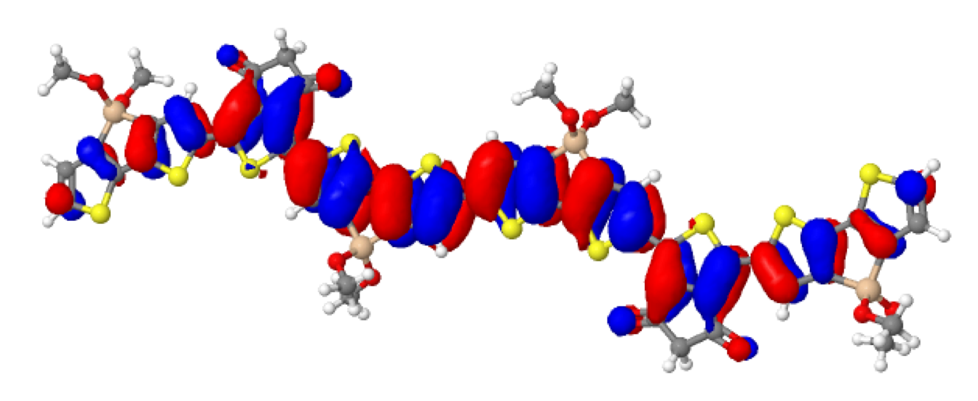
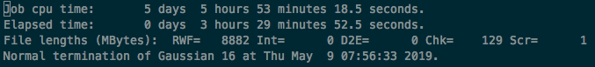
Computationally expensive, first-principles modeling of molecules
Quantum mechanics / density function theory can provide detailed insight into molecular properties
But, computation time is often onerous for high-throughput screening (days per molecule)

Slide 17
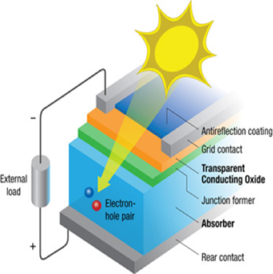
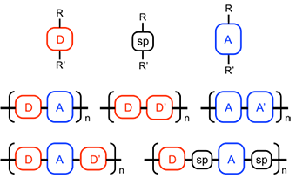
Application to a large-scale computational database
HOMO, LUMO, Band Gap play a role in determining device efficiency
Large, combinatorial search typically explored via DFT
NREL’s OPV Database: ~100,000 DFT calculations of electronic properties
Notes:
End-to-end learning is able to fit large-scale computational databases of DFT results, to the point where prediction errors are as small as the experimental error to measure related properties.
The process to predict DFT results is therefore orders of magnitude smaller: (multiple hours per compound to generate the DFT results, compared with thousands of compounds per second to predict using ML).
We can therefore use the trained ML algorithm to screen much larger swaths of chemical space in the search of top-performing polymers.

Slide 18
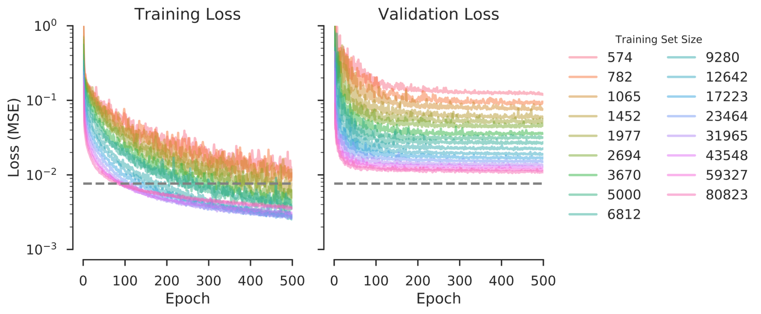
Training Neural Networks with increasing Polymer Data
Optimal Error Rate

Slide 19
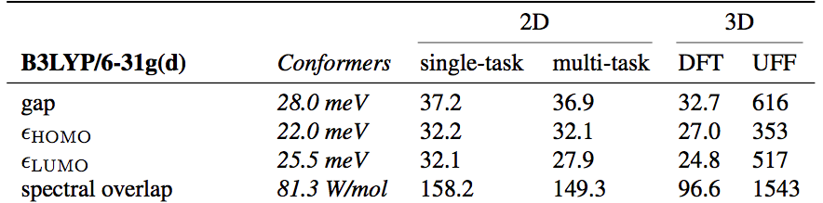
Error distributions are close to expected optimum, w/o 3D coordinates
Our mean absolute error for HOMO energy is ~30meV, similar to earlier studies

Slide 20
Unrolling molecules of different sizes
Typical RNNs pad inputs to a similar length. Here, we unroll atom and bond indexes into the batch dimension
Allows us to use BatchNorm, Dense layers without having to keep track of missing atom mask

Slide 21
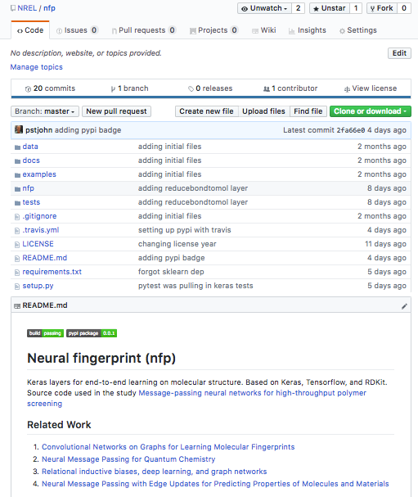
Keras implementation
Preprocessing functions implemented using RDKit
Graph neural network layers implemented using Keras
Github repo available: github.com/nrel/nfp

Slide 22
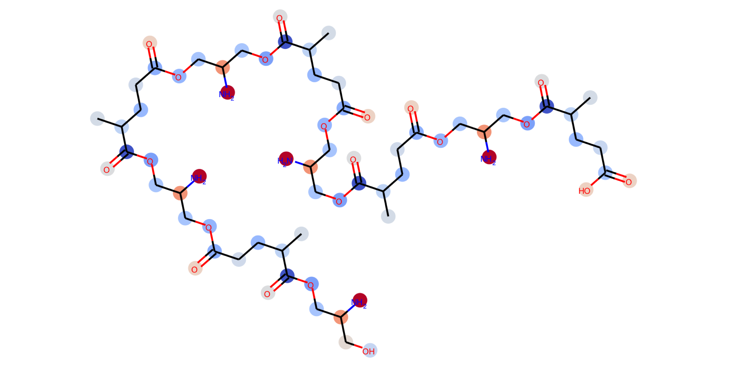
Constraining network structure
Predictions can be generated at the atom level, bond level, or molecule level
ATOMIC
CONTRIBUTION
Battaglia et al (2018) Relational inductive biases, deep learning, and graph networks arXiv:1806.01261

Slide 23
Acknowledgements
Robert Paton
Yanfei Guan
Seonah Kim
Nolan Wilson

